Slide 1

22MY U55X Rear Seat Occupant Alert (RSOA) July 23rd. 2020

Slide 2
Rear Seat Occupant Alert- RSOA
Background
RSOA is new feature within Ford, to monitor vehicle conditions and remind the driver to check rear seat for occupants at ignition OFF.

Slide 3
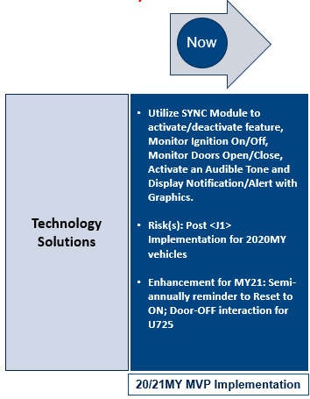
Proposed RSOA Feature Solution And Development Timeline- (Presented in CPRM 09-03-2019)

Slide 4


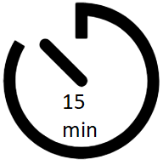
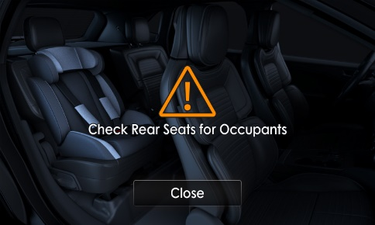

Background MY20/MY21: RSOA Feature – How Does It Work?
Rear Seat Occupant Alert -- Variant 1
ARMED
Ignition OFF→ ON
Open/Close Rear Door
Timer
ARMED
Ignition OFF→ ON
Open/Close Rear Door
Visual
Alert
Ignition ON→ OFF
Audible
Alert
“Chime”

Slide 5
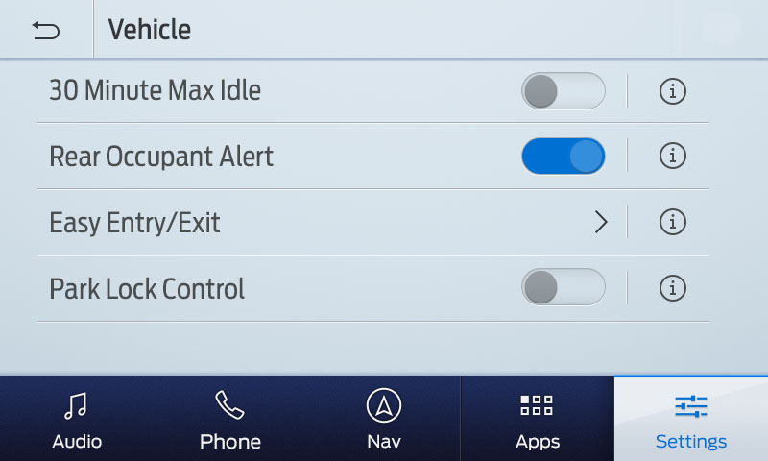
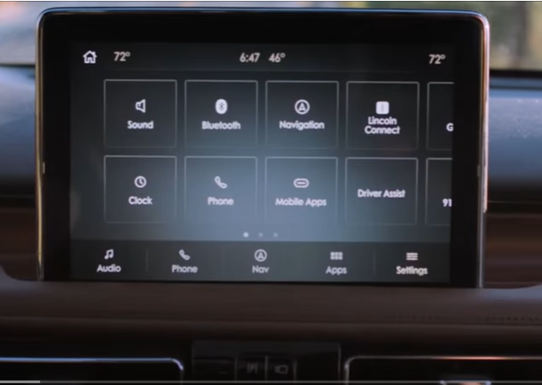
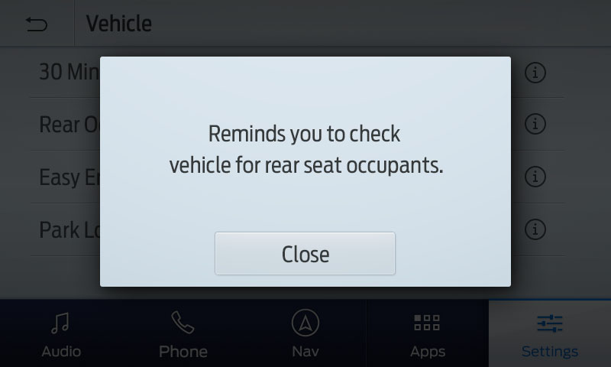
Background MY20/MY21: RSOA Feature Description UX
8” and 10” Screen
The rear seat pop-up will be displayed and audible tone will be heard for 10 seconds. A close button is also displayed to exit prior to 10 seconds notification.
Vehicle tile is on page 1 of settings for both 3.2v2 & SYNC 4

Slide 6
